Slide 1
3
Managers and Management

Slide 2
Learning Outcomes
Tell who managers are and where they work
Define management
Describe what managers do
Explain why it’s important to study management
Describe the factors that are reshaping and redefining management

Slide 3

Who Are Managers? Where Do They Work?
Organization
A deliberate arrangement of people brought together to accomplish a specific purpose.
Common Characteristics of Organizations
Distinct purpose
People working together
A deliberate systematic structure
Notes:
Managers work in organizations. We define organizations as A deliberate arrangement of people brought together to accomplish some are deliberate arrangements of people to accomplish a specific purpose. Examples include your college or university, the United Way, your neighborhood convenience store, the Dallas Cowboys football team, fraternities and sororities, the Cleveland Clinic and Nokia.

Slide 4
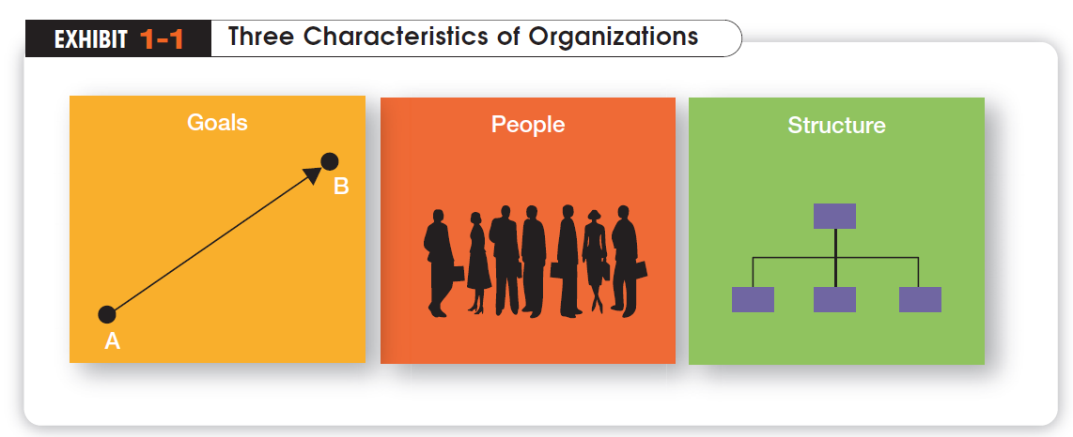

Slide 5


How Are Managers Different from Nonmanagerial Employees?
Nonmanagerial Employees
People who work directly on a job or task and have no responsibility for overseeing the work of others.
Examples, associates, team members
Managers
Individuals in organizations who direct the activities of others.
Notes:
For simplicities sake, we can divide organization members into two categories: nonmanagerial employees and managers. Nonmanagerial employees do not oversee the work of others. Managers direct and oversee the activity of the people in the organization.

Slide 6
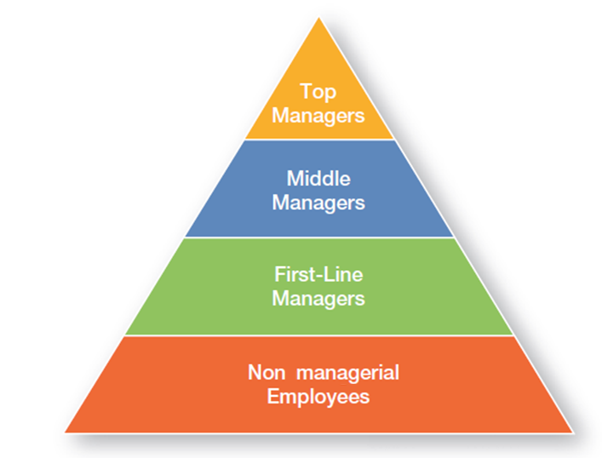
Management Levels
Top Managers
Responsible for making decisions about the direction of the organization.
Examples; President, Chief Executive Officer, Vice-President
Middle Managers
Manage the activities of other managers.
Examples; District Manager, Division Manager
First-line Managers
Responsible for directing nonmanagerial employees
Examples; Supervisor, Team Leader

Slide 7

What Is Management?
Management
The process of getting things done effectively and efficiently, with and through people
Effectiveness
“Doing the right things”, doing those tasks that help an organization reach its goals
Efficiency
Concerned with the means, efficient use of resources like people, money, and equipment
Notes:
Management is a process of getting things done, effectively and efficiently, with through people. A process is a set of ongoing and interrelated activities. In our definition it refers to the primary activities or functions managers perform.

Slide 8
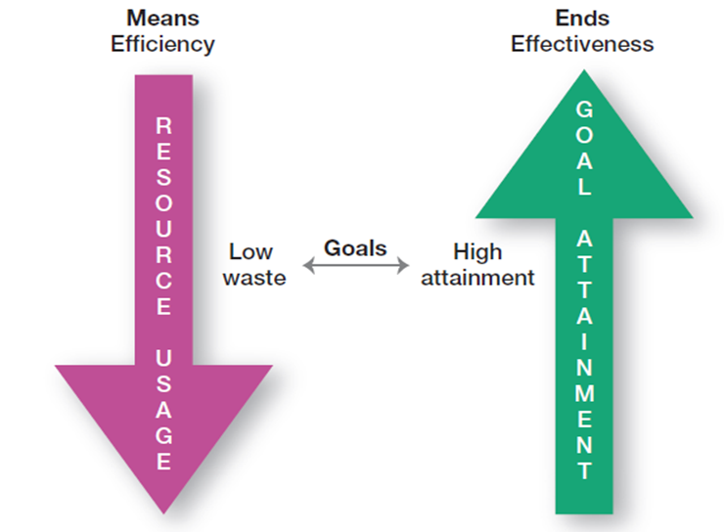
Efficiency v Effectivity
Notes:
The words efficiency and effectivity are often incorrectly used interchanged. While efficiency is about achieving optimal output, effectivity focus on achieving the goals

Slide 9

What Do Managers Do?
In the functions approach proposed by French industrialist Henri Fayol, all managers perform certain activities or functions
Notes:
Henri Fayol, a French industrialist in the early twentieth century, proposed that all managers perform five management activities: plan, organize, command, coordinate and control. Today these management functions have been condensed to four.

Slide 10
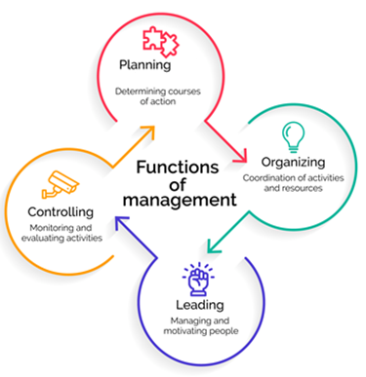
Four Management Functions
Planning
Defining the organizational purpose and ways to achieve it
Organizing
Arranging and structuring work to accomplish organizational goals
Leading
Directing the work activities of others
Controlling
Monitoring, comparing, and correcting work performance
Notes:
Planning includes defining goals, establishing strategy, and developing plans to coordinate activities. Organizing includes determining what tasks need to be done and by whom. Leading includes motivating, directing the activities of others, and resolving conflicts. Controlling involves monitoring, comparing, and correcting work performance.

Slide 11
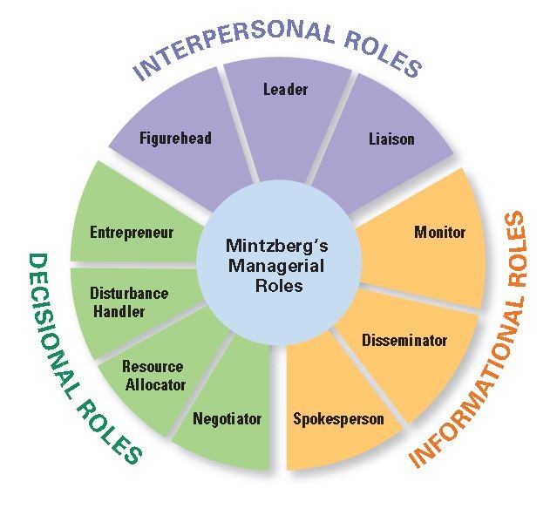
What Roles Do Managers Play?
Henry Mintzberg observed that a manager’s job can be described by ten roles performed by managers in three general categories
Notes:
In the 1960s, Henry Mintzberg did an empirical study of chief executives and discovered that managers were engaged in a number of varied, un-patterned, and short-duration activities. He defined management by categorizing what managers do based on the managerial roles they perform at work.

Slide 12
What Skills Do Managers Need?
Robert Katz and others describe four critical skills in managing
Conceptual Skills
Used to analyze complex situations
Interpersonal Skills
Used to communicate, motivate, mentor and delegate
Technical Skills
Based on specialized knowledge required for work
Political Skills
Used to build a power base and establish connections
Notes:
Another way to describing what managers do is by looking at the skills they need in managing. Managers must possess four critical skills in managing. Conceptual skills, Interpersonal Skills, Technical Skills and Political Skills.

Slide 13
Is The Manager’s Job Universal?
The previous discussion describe management as a generic activity. In reality, a manager’s job varies with along several dimensions
Level in the Organization
Top level managers do more planning than supervisors
Profit vs. Nonprofit
Management performance is measured on different objectives
Notes:
While the importance of managerial roles varies depending on a manager’s position within an organization, the differences are of degree and emphasis, not of function. As managers move up the organization, for example, they spend less time supervising and more time planning.
All managers, however, make decisions and plan, lead, organize, and control. But the amount of time they give to each activity is not necessarily constant. In addition, the content of the managerial activities changes with the manager’s level.
When measuring managerial performance in business, profit (the bottom line) is an unambiguous criterion. Even though not-for-profit organizations need money to survive, however, their managers do not live and die to maximize profits.
Given this difference, managers working in profit and not-for-profit organizations must perform similar functions: planning, organizing, leading, and controlling.

Slide 14

Is the Manager’s Job Universal? (cont’d)
Size of the Organization
Small businesses require an emphasis in the management role of spokesperson
National Borders
These concepts work best in English-speaking countries and may need to be modified in other global environments

Slide 15
The Economic Crisis - 2008
Began with turmoil in mortgage markets
Spread to businesses when broader credit markets collapsed
Called the worst since the Great Depression
Foreclosures, financial recession, a huge public debt, and widespread social problems from job losses signal that the U.S. and global economic environments have changed and are continuing to change
Notes:
This economic crisis, which began with turmoil in mortgage markets and spread to businesses when broader credit markets collapsed, has been called the worst since the Great Depression. With foreclosures, financial recession, a huge public debt, and widespread social problems from job losses, it’s clear that the U.S. and global economic environments have changed and are continuing to change. For instance, the International Monetary Fund forecasted that the global economy would likely contract in 2009 for the first time since World War II and that the recovery would take longer than expected

Slide 16
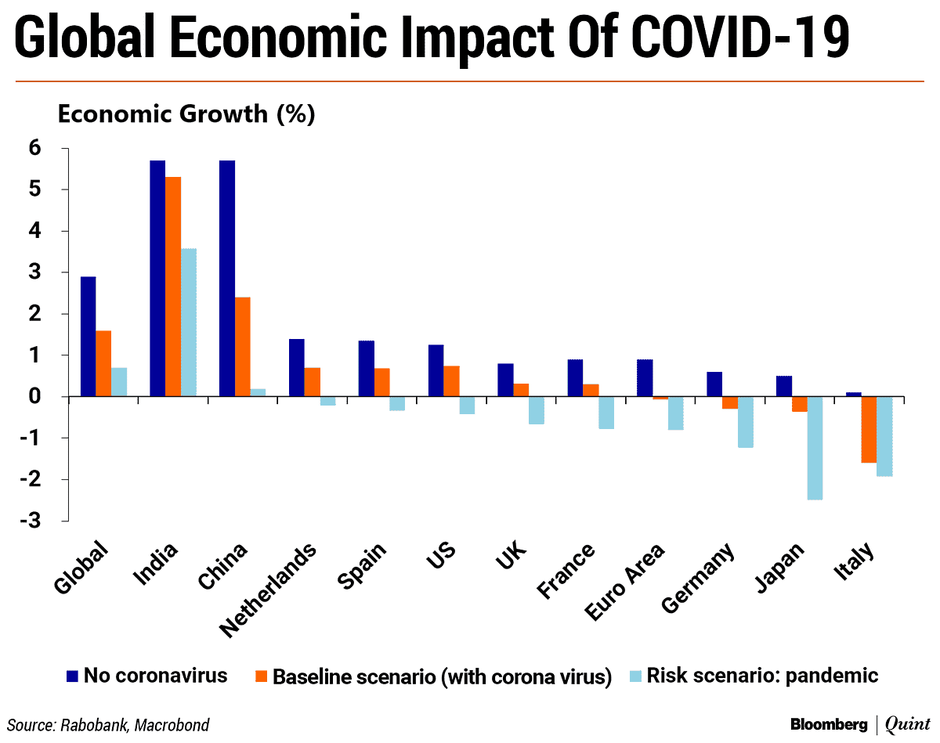
The Economic Crisis – 2020-2021
Began with uncertainties over Covi19 impact on markets
Many businesses entered lockdown creating panic and chain reaction
Many large industries turned to Government for rescue package
Further foreclosures, financial recession, a huge public debt, and widespread social problems from job losses
Many changes to global economic environments have changed creating lasting impact
Notes:
This economic crisis, which began with turmoil in mortgage markets and spread to businesses when broader credit markets collapsed, has been called the worst since the Great Depression. With foreclosures, financial recession, a huge public debt, and widespread social problems from job losses, it’s clear that the U.S. and global economic environments have changed and are continuing to change. For instance, the International Monetary Fund forecasted that the global economy would likely contract in 2009 for the first time since World War II and that the recovery would take longer than expected

Slide 17
What Does the Workforce Look Like Today?
Those born before 1946 - 6 percent of the workforce
Baby boomers , born between 1946 and 1964 - 41.5 percent of the workforce
Generation X, born 1965 to 1977 - 29 percent of the workforce
Gen Y , born 1978 to 1994 - 24 percent of the workforce.
Gen Z is the newest generation to be named and were born between 1995 and 2015 – the future work force from 2025.
Notes:
Much of the change in the U.S. workforce over the last 50 years can be attributed to federal legislation enacted in the 1960s that prohibited employment discrimination. With these laws, avenues opened up for minority and female job applicants. These two groups dramatically changed the workplace in the latter half of the twentieth century. Women, in particular, have changed the composition of the workforce as they now hold some 49.1 percent of jobs

Slide 18
What Will the “New” Normal Be Like?
The New Normal
“Capitalism will be different” Timothy Geithner, the U.S. Secretary of the Treasury
Increased role of government, especially in financial markets
Government spending is now at levels not seen since World War Two
Public concerns about the growing budget deficit and increased government intervention in the economy.
Notes:
Experts believe that once the U.S. economy emerges from recession things won’t be the way they were—that there will be a “new” normal. As Timothy Geithner, the U.S. Secretary of the Treasury, said, “Capitalism will be different.”10 How managers manage and the way
businesses operate will not be as they’ve always been. The biggest change is likely to be in the role of government, especially in financial markets and in consumer protection

Slide 19
How Are Managers Adapting to a Changing Workforce?
Family-Friendly Benefits
Benefits that provide a wide range of scheduling options that allow employees more flexibility at work, accommodating their needs for work/life balance
Contingent Workforce
Few core workers and rest are Part-time, temporary, and contract workers who are available for hire on an as-needed basis
Notes:
Today’s progressive workplaces must accommodate the varied needs of a diverse workforce. In response, many organizations are offering family-friendly benefits, benefits that provide a wide range of scheduling options that allow employees more flexibility at work, accommodating their need for work/life balance.

Slide 20
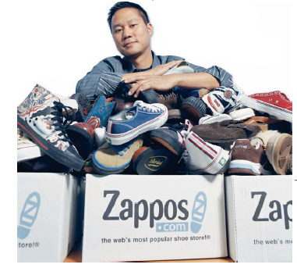
Why Is Innovation Important to the Manager’s Job?
“Nothing is riskier than not innovating”
Innovation isn’t just important for high technology companies but essential in all types of organizations

Slide 21

Why Are Customers Important to the Manager’s Job?
Without customers most organizations would cease to exist
Today we’re discovering that employee attitudes and behaviors play a big part in customer satisfaction
Managers must create a customer responsive where employees are friendly, knowledgeable, responsive g to customer needs

Slide 22
The End

